Slide 1
Notes:
What is your level of familiarity with Open Educational Resources (OER)?
https://www.polleverywhere.com/multiple_choice_polls/nE28v7lOaX3GPtr

Slide 2
Leveraging OER: Creating an Affordable and Customized Student Learning Experience
Bruce M. Wilson, Ph.D. Political Science
James R. Paradiso, M.Ed. Center for Distributed Learning

Slide 3
Seminar Objectives
Define Open Educational Resources (OER)
Explore the richness and different types of openly-licensed educational materials
Identify where to find open-licensed educational materials
Recognize benefits from a faculty member’s perspective and use of OER
Consider potential use cases for OER in your course(s)

Slide 4
Open Educational Resources (OER)
Let’s begin with a definition:
“Open Educational Resources are teaching, learning and research materials…that reside in the public domain or have been released under an open license that permits no-cost access, use, adaptation and redistribution by others with no or limited restrictions.”
– The William and Flora Hewlett Foundation

Slide 5
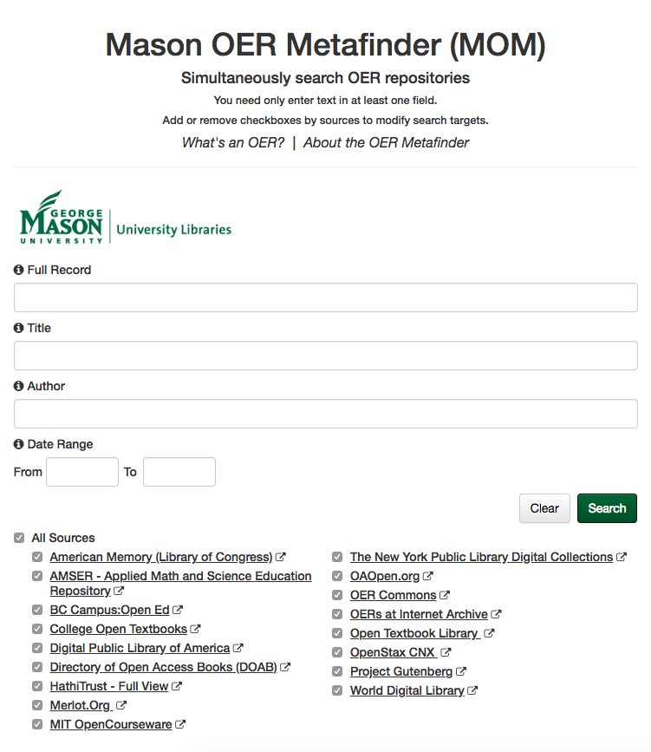
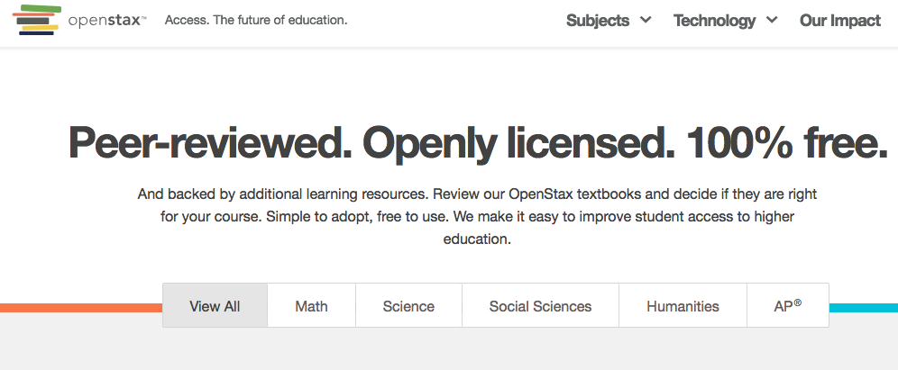
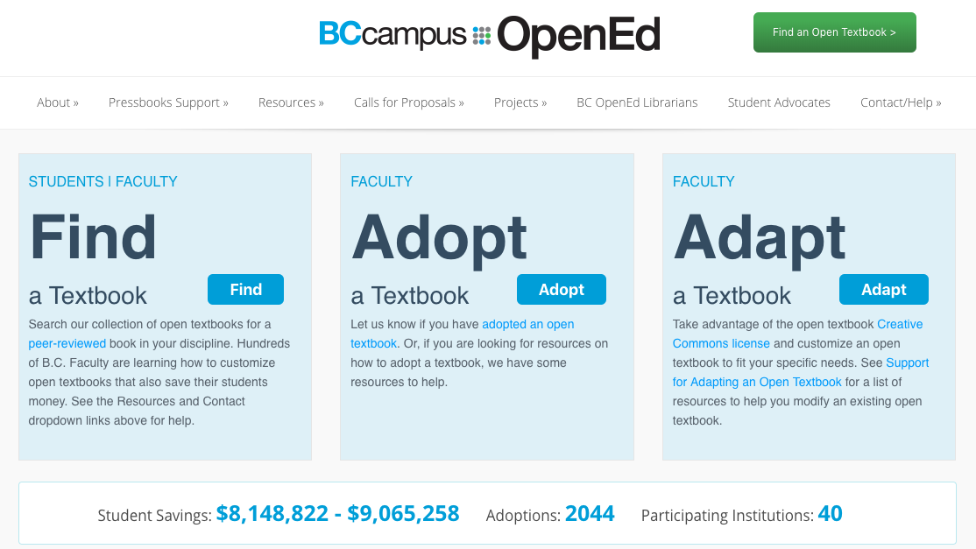

Slide 6
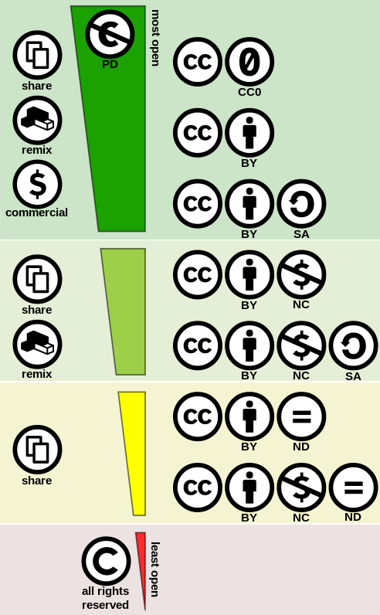
Open-License Types
Attribution / CC BY This license lets others distribute, remix, tweak, and build upon your work, even commercially, as long as they credit you for the original creation. | Attribution-NonCommercial / CC BY-NC This license lets others remix, tweak, and build upon your work non-commercially, and although their new works must also acknowledge you and be non-commercial, they don’t have to license their derivative works on the same terms.
Attribution-ShareAlike / CC BY-SA This license lets others remix, tweak, and build upon your work even for commercial purposes, as long as they credit you and license their new creations under the identical terms. | Attribution-NonCommercial-ShareAlike / CC BY-NC-SA This license lets others remix, tweak, and build upon your work non-commercially, as long as they credit you and license their new creations under the identical terms.
Attribution-NoDerivs / CC BY-ND This license allows for redistribution, commercial and non-commercial, as long as it is passed along unchanged and in whole, with credit to you. | Attribution-NonCommercial-NoDerivs CC BY-NC-ND This license is the most restrictive of our six main licenses, only allowing others to download your works and share them with others as long as they credit you, but they can’t change them in any way or use them commercially.
By Shaddim / CC BY 4.0, via Wikimedia Commons
Adapted from Creative Commons by J. Paradiso / CC BY 4.0

Slide 8
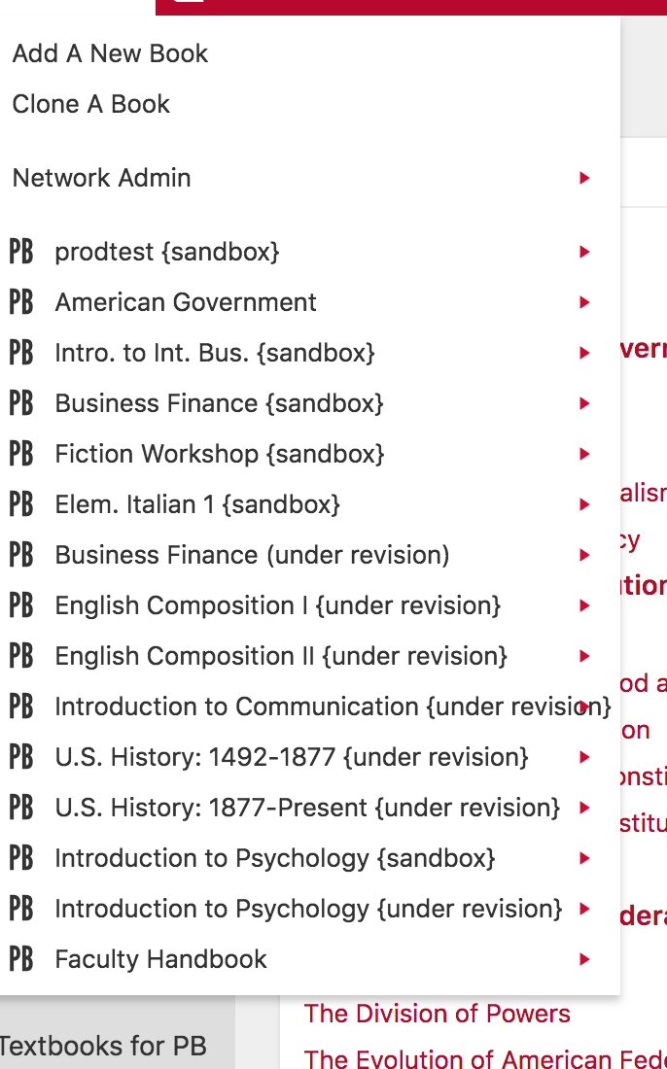
Encouraging adoption through a repository of pre-prepared titles

Slide 10
Student Access to Learning Materials
Concerns
Cost / Financial Aid
$100-150 typical textbook / $60-70 for Gov’t 7, 8...etc.
Financial obstacles / delayed financial aid
Perform poorly in early modules (no access to book)
Publisher / Bookstore
Frequent new editions/updates (problematic)
Unaccommodating
Summer A start
Midterm
(3 weeks in)
Financial aid
disburses
82%
Students delayed
buying a course book at least once due to cost¹
82%
Students surveyed delayed
Buying a course book at
¹Students surveyed at UCF

Slide 11
Student Access to Learning Materials
Solutions
Cost / Financial Aid
$0, openly-licensed textbook (OpenStax: American Government)
No funding required
Publisher / Bookstore
Open authoring capabilities (via Pressbooks)
Textbook can be exported (free) and/or printed (little cost)
72%
Undergraduate students
received financial aid²
72%
Undergraduate students
received financial aid
²UCF Facts 2017-2018 https://www.ucf.edu/about-ucf/facts/

Slide 12
Student Access to Learning Materials
Results / Benefits
Reduce student anxiety/hurdles
All students gain free access to required learning materials (OER) on day one
Flexible learning platform that integrates seamlessly with LMS (Pressbooks)
Reduced faculty anxiety
Stick to schedule without harming students with fewer resources
No panicked student emails concerning access to required textbook
Significant creative control (variable, depending on license type)

Slide 13
Pressbooks in Webcourses@UCF

Slide 14
Embedded in Webcourses@UCF

Slide 15
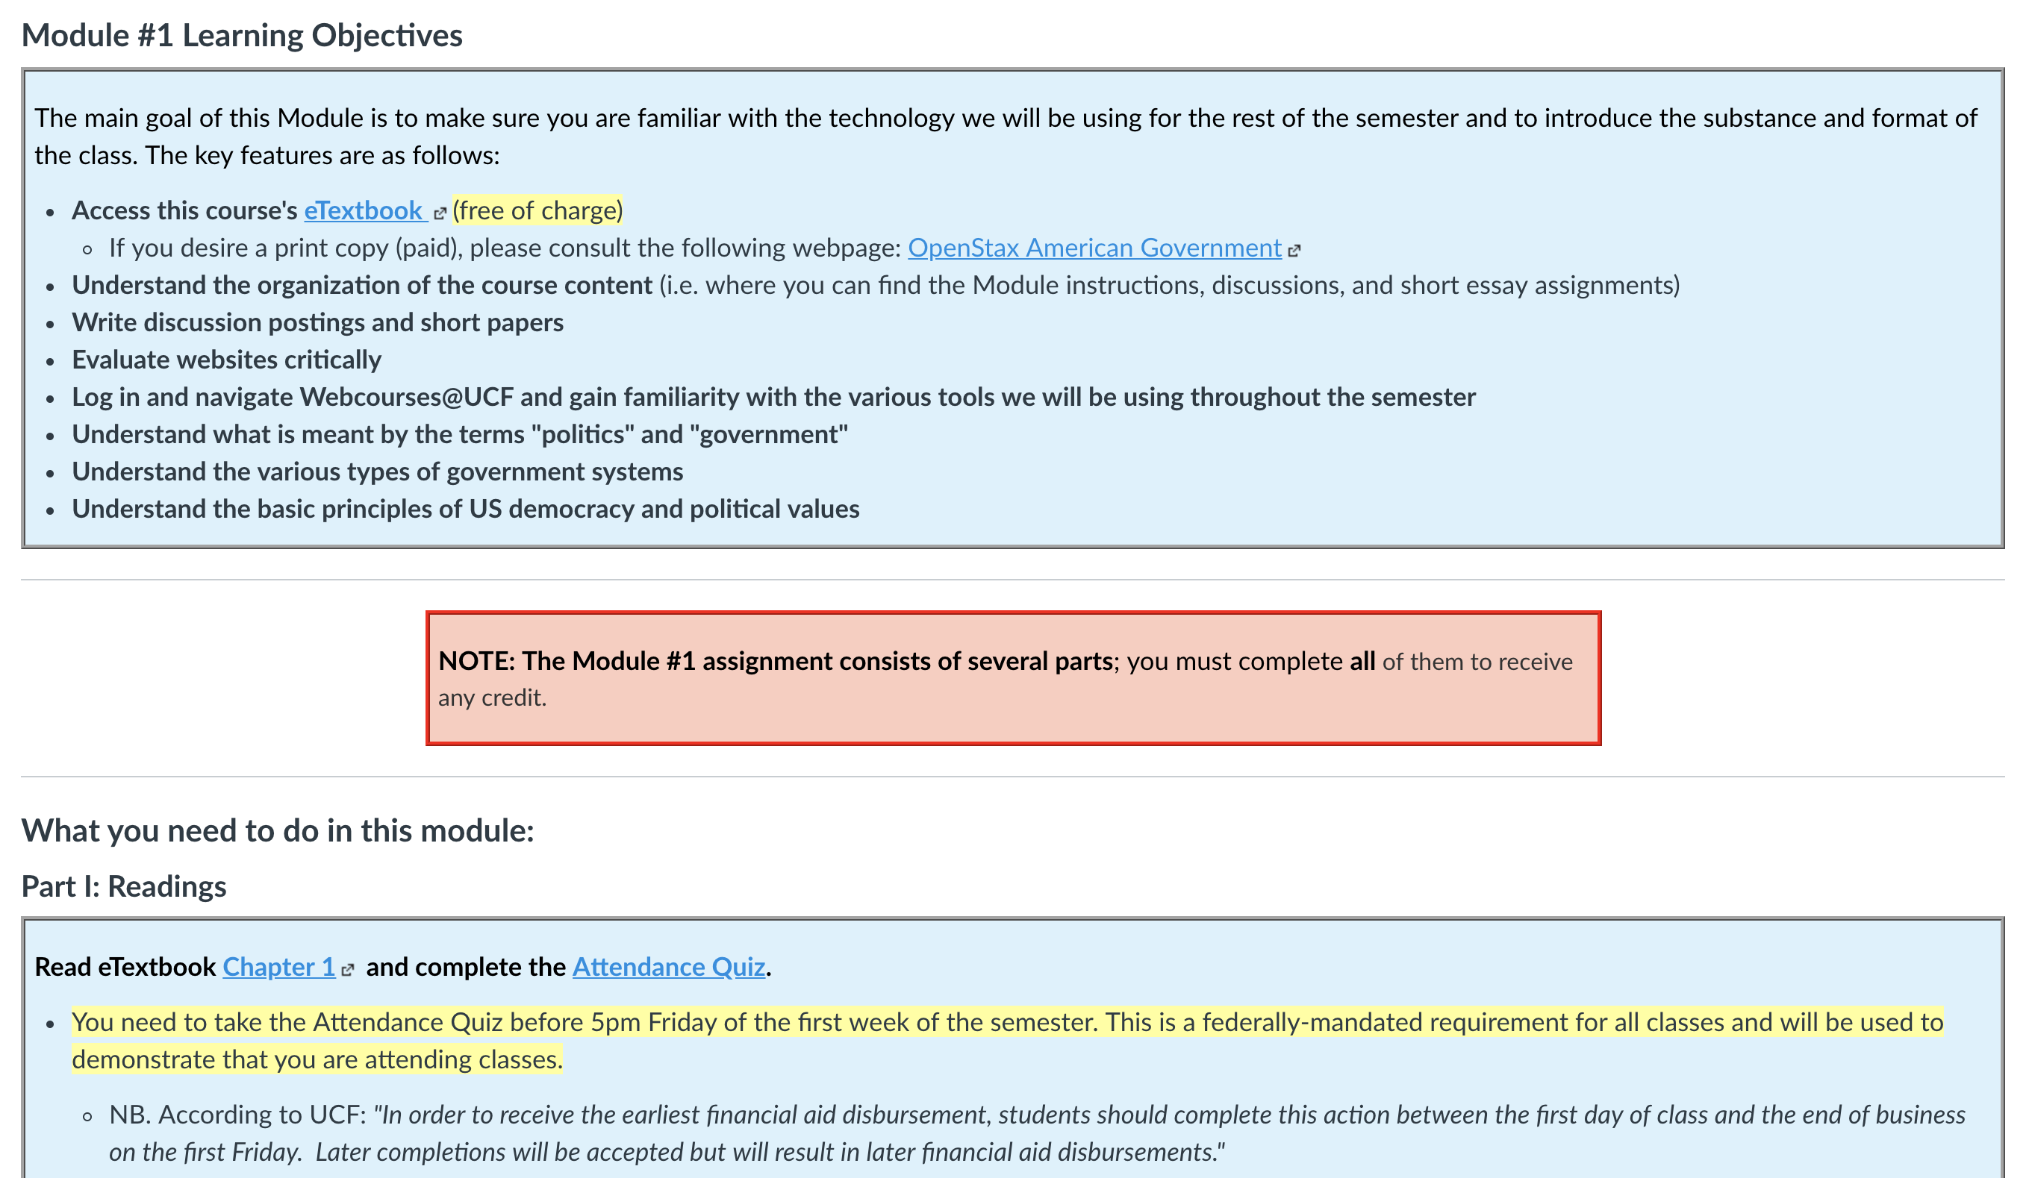
Pressbooks in Webcourses@UCF

Slide 16
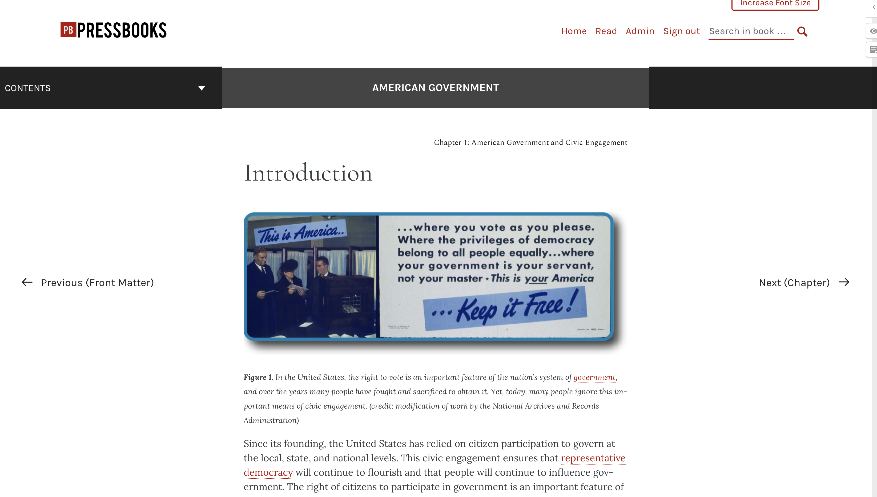
Viewed on the Web

Slide 17
Where can I find additional resources?
If you’d like to learn more about OER and/or gain access to the rich amount of openly-licensed content available to you on the internet, please refer to this seminar’s resource page: http://dl.ucf.edu/oer

Slide 18
Questions?
Want assistance with OER?
Contact your Instructional Designer
Supporting Materials:
dl.ucf.edu/oer
Take the Survey:
dl.ucf.edu/feedback

